Slide 1
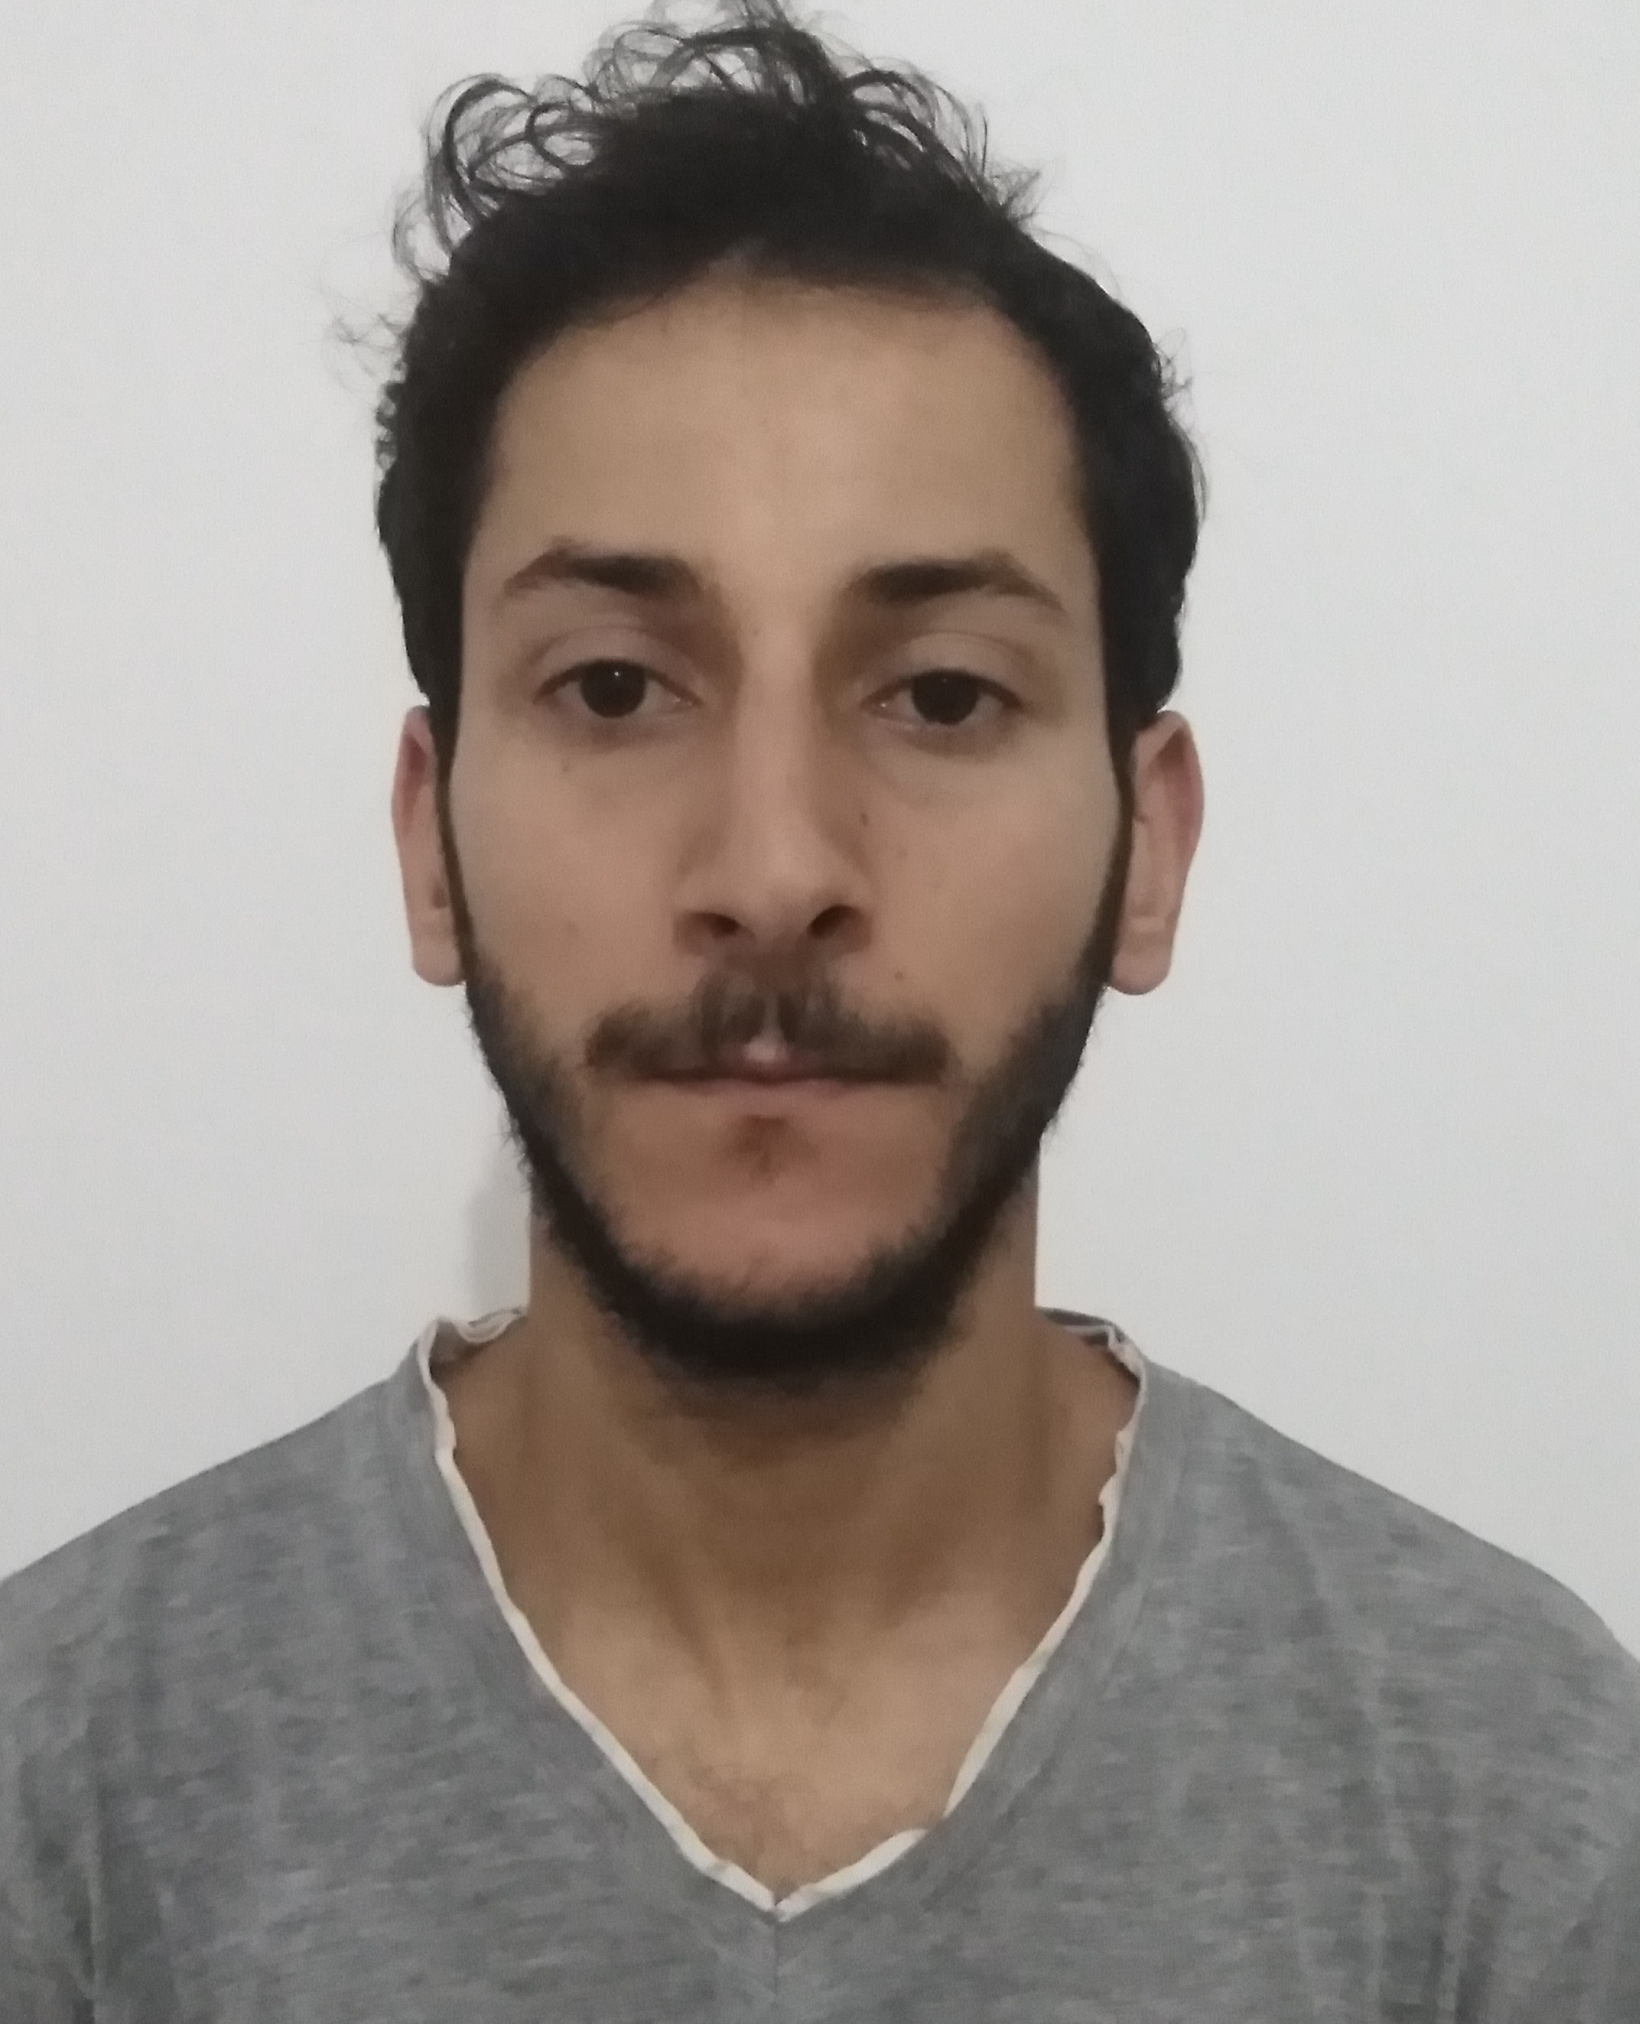




CV
CONTACT
TELEPHONE
EMAIL
+216 53 823 942
E3.92@live.com
ADRESSE
RESEAUX
Ben Yahya Khaled
Rue Mohamed Ben Amor, Béni Khiar, 8060 Nabeul
https://www.facebook.com/KingMathers9
PROFESSIONNEL EXPERIENCE
ABOUT
09/11/2009 – 31-10-2011 | Technician internship| Bel Azur Hotels
-Use basic tooling -Install cables and pipes -Use plans and quotes -Install and maintain light fixtures and fireplaces -Install and maintain electrical outlets, antennas and circuits
-Install a backup power system -Realize cabling work related to an industrial application -Install an air recycling system -Install and maintain relative automations with building -Install and mount the cable trays
01/10/2013 – 31-12-2013 | Electrician assistant| Bel Azur Hotels
-Renovation of bungalows -Maintenance and installation of electrical equipment, Fixing, Repairing
31/12/2013 – 31/03/2015 | Electrician| Bel Azur Hotels
-Renovation of all floors and blocks of the hotel -Maintenance and installation of electrical equipment, fixing, repair.
13/11/2017 – 23/06/2018 | Electrician| LTI Les Orangers Garden Villas & Bungalows
-Renovation of all floors and blocks of the hotel -Maintenance and installation of electrical equipment, fixing, repair.
Born on the 30/03/1992 Single I am a qualified and experienced electrician in the practice of installation, electrical calculation note, maintenance and testing of electrical systems of domestic electricity. Rigorous, versatile, autonomous. In search, of a contract of work.
LANGUAGES
English
French
Arabic
SKILLS
Microsoft Word
Microsoft
PowerPoint
TRAINING - DIPLOMA
09/11/2009 - 31-10-2011 - (CAP) Building Electricity Installer- (CSFM Nabeul) Maintenance Training Sector Center of Nabeul in Tunisia
Hobbies
Sport (Football, Music and Films, Musculation)

